Slide 1
OOP Inheritance
Università di Modena e Reggio Emilia
Prof. Nicola Bicocchi (nicola.bicocchi@unimore.it)

Slide 2

Motivation
They all move, have a shape, shields, and weapons. Can they share the same code?

Slide 3
Motivation
Frequently, a class is merely a modification of another class. Inheritance allows minimal repetition of the same code
A new design created by changing an existing design. (The new design consists of only the changes)
Localization of code
Fixing a bug in the base class automatically fixes it in the subclasses
Adding functionalities to the base class automatically adds them to the subclasses
Reduced chances of different (and inconsistent) implementations of the same operation

Slide 4
Inheritance
A class can be a sub-type of another class
The inheriting class contains all the attributes and methods of the class it inherited from
The inheriting class can define additional attributes and methods
The inheriting class can override the definition of existing methods by providing its own implementation
The code of the inheriting class consists only of the changes and additions to the base class

Slide 5
Example I (extension)
Class Car {
boolean isOn;
String licensePlate;
void turnOn() {…}
void turnOff() {…}
}
Class SDCar extends Car {
boolean isSelfDriving;
void turnSDOn() {…}
void turnSDOff() {…}
}
SDCar c = new SDCar();
c.turnOn(); // OK!
c.turnSDOn(); // OK!
*SD = Self Driving

Slide 6
Example II (override)
Class Car {
boolean isOn;
String licensePlate;
void turnOn() {…}
void turnOff() {…}
}
Class SDCar extends Car {
boolean isSelfDriving;
/* method override */
void turnOn() {
turnSDOff();
/* … */
}
/* method override */
void turnOff() {
turnSDOff();
/* … */
}
void turnSDOn() {…}
void turnSDOff() {…}
}

Slide 7
Example III (override)
Class Car {
boolean isOn;
string licensePlate;
void turnOn() {…}
void turnOff() {…}
}
Class SDCar extends Car {
boolean isSelfDriving;
/* override */
void turnOn() {
turnSDOff();
super.turnOn();
}
void turnOff() {
turnSDOff();
super.turnOff();
}
void turnSDOn() {…}
void turnSDOff() {…}
}

Slide 8
Class SDCar
Inherits
attributes (isOn, licencePlate)
methods (turnOn, turnOff)
Adds
attributes (isSelfDriving)
methods (turnSDOn, turnSDOff)
Modifies (overrides)
methods (turnOn, turnOff)
Class SDCar extends Car {
boolean isSelfDriving;
/* override */
void turnOn() {
turnSDOff();
super.turnOn();
}
void turnOff() {
turnSDOff();
super.turnOff();
}
void turnSDOn() {…}
void turnSDOff() {…}
}

Slide 9
this and super
this is a reference to the current object
super is a reference to the parent class

Slide 10
Terminology
Class one above
Parent class
Class one below
Child class
Class one or more above
Superclass, Ancestor class, Base class
Class one or more below
Subclass, Descendent class

Slide 11
Visibility and Inheritance

Slide 12
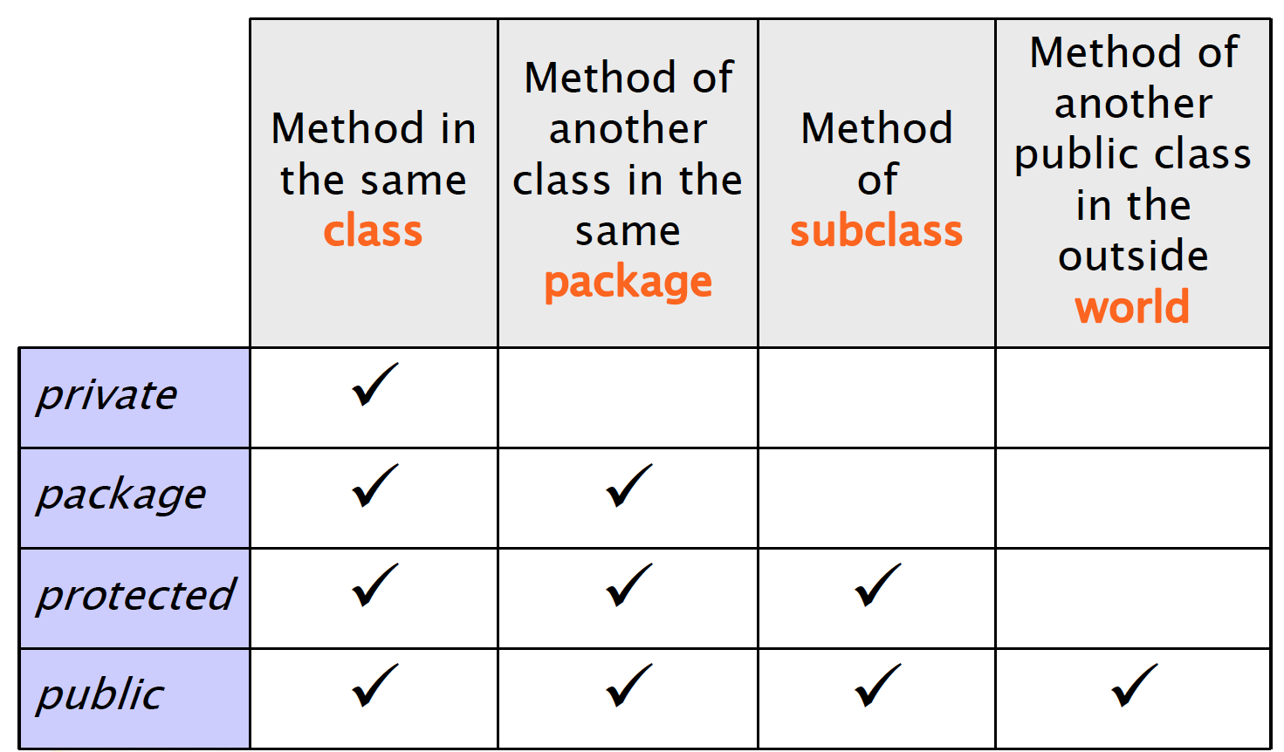
Recap

Slide 13
Visibility
Class Car {
private boolean isOn;
private string licensePlate;
public void turnOn() {…}
public void turnOff() {…}
}
Class SDCar extends Car {
void print() {
/* Do not work! Not visible! */
System.out.println(licencePlate);
}
}

Slide 14
Visibility
Class Car {
boolean isOn;
string licensePlate;
public void turnOn() {…}
public void turnOff() {…}
}
Class SDCar extends Car {
void print() {
/*
* Works if Car and SDCar
* share the same package
*/
System.out.println(licencePlate);
}
}

Slide 15
Visibility
Class Car {
protected boolean isOn;
protected string licensePlate;
public void turnOn() {…}
public void turnOff() {…}
}
Class SDCar extends Car {
void print() {
/* Works anyway! */
System.out.println(licencePlate);
}
}

Slide 16
Inheritance and constructors

Slide 17
Construction of child objects
Since each subclass “contains” an instance of the parent class, the latter must be initialized
Java compiler automatically calls the default constructor (no params!) of the parent class
The call is inserted as the first statement of each child constructor. If parent class disabled default constructor (by defining others) parent constructor must be called explicitly!

Slide 18
super()
this is a reference to the current object
super is a reference to the parent class
super() calls the default constructor of parent class
super(params) calls other constructors of parent class
Must be the first statement in child constructors

Slide 19
Example
class Car {
boolean isOn;
String licensePlate;
/* Default constructor enabled! */
}
class SDCar extends Car {
boolean isSelfDriving;
/* Default constructor enabled! */
} // Works!

Slide 20
Example
class Car {
boolean isOn;
String licensePlate;
/* Default constructor enabled! */
}
class SDCar extends Car {
boolean isSelfDriving;
/* Default constructor disabled! */
public SDCar() {
/* automatic call to parent default constructor here! */
}
} // Works!

Slide 21
Example
class Car {
boolean isOn;
String licensePlate;
/* Default constructor disabled! */
public Car(String licensePlate) {
this.licencePlate = licensePlate;
}
}
class SDCar extends Car {
boolean isSelfDriving;
/* Default constructor disabled! */
public SDCar() {
/* automatic call to parent default constructor here! */
}
} // Not working!

Slide 22
Example
class Car {
boolean isOn;
String licensePlate;
/* Default constructor disabled! */
public Car(String licensePlate) {
this.licencePlate = licensePlate;
}
}
class SDCar extends Car {
boolean isSelfDriving;
/* Default constructor disabled! */
public SDCar(String licencePlate) {
super(licencePlate);
isSelfDriving = false;
}
} // Works!

Slide 23
Construction of child objects
Execution of constructors proceeds top-down along the inheritance hierarchy
In this way, when a method of the child class is executed (constructor included), the super-class is completely initialized already

Slide 24
Example
class Car{
Car() {
super();
System.out.println(“New Car created”);
}
}
Class SDCar extends Car {
SDCar() {
super();
System.out.println(“New SDCar created”);
}
}
SDCar c = new SDCar(); // Which output?

Slide 25
Dynamic binding and polymorphism
Car[] garage = new Car[4];
garage[0] = new Car();
garage[1] = new SDCar();
garage[2] = new SDCar();
garage[3] = new Car();
for(Car c : garage) {
c.turnOn();
/* which method is actually called
* is not knowable at compile time! */
}

Slide 26
Dynamic binding and polymorphism
When using collections of objects belonging to a hierarchy of classes, methods actually called are known only at runtime.
The same call (methods with the same signature) might have different results (polymorphism) depending on the actual class of the object.
* https://en.wikipedia.org/wiki/Late_binding

Slide 27
Object

Slide 28
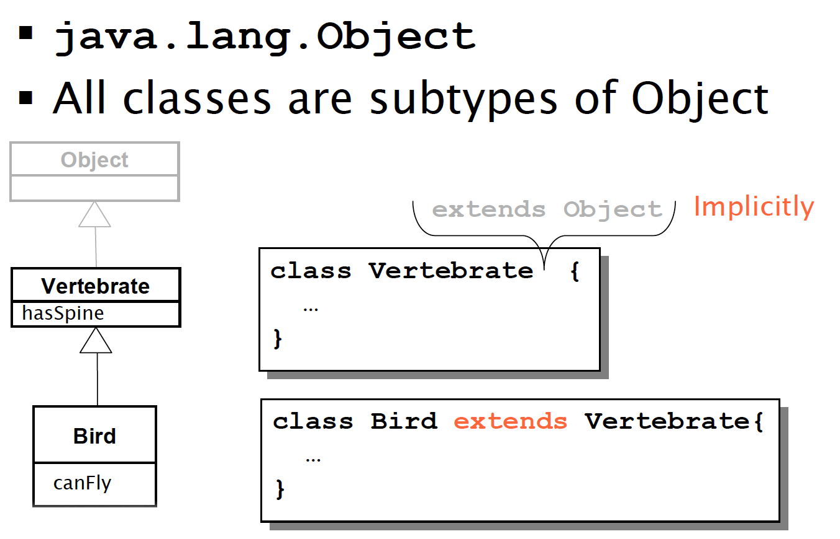
Java.lang.Object

Slide 29
Java.lang.Object
All objects can be seen as Object instances
Object defines basic services, which are useful for all classes. They are often overridden in sub-classes. For example:
toString(): returns a string representation
equals(Object o): tests equality
clone(): returns a shallow copy of the object

Slide 30
toString()
class Car{
String licencePlate;
public String toString(){
return “[Car] ” + licencePlate;
}
}
Car c = new Car();
// println(Object) call
System.out.println(c);
// println(String) call
System.out.println(c.toString());

Slide 31
equals(Object o)
public class Car {
boolean isOn;
String licencePlate;
public Car(boolean isOn, String licencePlate) {
this.isOn = isOn;
this.licencePlate = licencePlate;
}
public static void main(String[] args) {
Car c1 = new Car(true, "AA334GG");
Car c2 = new Car(true, "AA334GG");
System.out.println(c1.equals(c2)); //false!
}
}

Slide 32
equals(Object o)
public class Car {
boolean isOn;
String licencePlate;
public Car(boolean isOn, String licencePlate) {
this.isOn = isOn;
this.licencePlate = licencePlate;
}
/* the equals() methods must be overridden */
public boolean equals(Object obj) {
Car other = (Car) obj;
if (isOn != other.isOn)
return false;
if (licencePlate != other.licencePlate)
return false;
return true;
}
}

Slide 33
Casting

Slide 34
Types
Java is a strictly typed language. Each variable has a type!
float f;
f = 4.7; //OK!
f = “hello!”; //!OK
Car c;
c = new Car(); //OK!
c = new String(); //!OK

Slide 35
Upcasting and Downcasting
class Car {};
class SDCar extends Car {};
Car c1 = new Car(); // OK!
SDcar c2 = new SDCar (); // OK!
But also…
Car c3 = new SDcar();

Slide 36
Upcasting and Downcasting
Car c3 = new SDcar();
Specialization defines a sub-typing relationship (is a ).
All SDCar(s) are Car(s). Not all Car(s) are SDCar(s).
Upcasting and downcasting refer to the possibility of changing the reference type of a given object. Upcasting consists in using more general references, while downcasting more specific references.
Upcast
Downcast
SDCar(s)
Car(s)

Slide 37
Upcasting and Downcasting
More general
Reference (Car)
More specific
Reference (SDCar)
Actual object methods (SDCar)

Slide 38
Upcasting
class Car {};
class SDCar extends Car {};
Car c = new SDCar();
Assignment from a more specific type to a more general type
Note well: reference type and object type are separate concepts. Object referenced by ‘c’ continues to be of SDCar type! Only the interface changes!

Slide 39
Upcasting
It is dependable
It is always true that an SDCar is a Car too
It is automatic
Car c = new SDCar();

Slide 40
Example
Class Car {
boolean isOn;
string licensePlate;
void turnOn() {…}
void turnOff() {…}
}
Class SDCar extends Car {
boolean isSelfDriving;
void turnSDOn() {…}
void turnSDOff() {…}
}
SDCar c1 = new SDCar();
c1.turnSDOn() // OK!
Car c2 = c1; // Upcast
c2.turnSDOn() // Compile time error!
(Car interface does not provide turnSDOn() call)

Slide 41
Downcasting
Assignment from a more general type (super-type) to a more specific type (sub-type)
Reference type and object type do not change
MUST be explicit
It’s a risky operation, no automatic conversion provided by the compiler (it’s up to you!)

Slide 42
Example
Class Car {
boolean isOn;
string licensePlate;
void turnOn() {…}
void turnOff() {…}
}
Class SDCar extends Car {
boolean isSelfDriving;
void turnSDOn() {…}
void turnSDOff() {…}
}
Car c1 = new SDCar();
c1.turnSDOn() // Compile time error!
SDCar c2 = (SDcar)c1; // Downcast
c2.turnSDOn() // Accidentally OK! The object referenced by c1 was actually of class SDCar

Slide 43
Example
Class Car {
boolean isOn;
string licensePlate;
void turnOn() {…}
void turnOff() {…}
}
Class SDCar extends Car {
boolean isSelfDriving;
void turnSDOn() {…}
void turnSDOff() {…}
}
Car c1 = new Car();
c1.turnSDOn() // Compile time error!
SDCar c2 = (SDcar)c1; // Downcast
c2.turnSDOn() // Run time error!

Slide 44
Runtime is evil
Compilers aid developers in writing working code. Runtime errors cannot be identified by compilers. Developers must be careful!
Use the instanceof operator
Car c = new SDCar();
if (c instanceof SDCar){
SDCar sdc = (SDCar) c;
sdc.turnSDOn();
}

Slide 45
Upcast to object
Each class is either directly or indirectly a subclass of Object
It is always possible to upcast any instance to Object type (see Collection)
AnyClass any = new AnyClass();
Object obj = (Object)any;

Slide 46
Abstract Classes and Interfaces

Slide 47
Abstract methods
You can declare an object without implementing it:
Person p;
Similarly, you can declare a method without implementing it (i.e., the body of the method is missing):
public abstract void draw(int size);
A method that has been declared but not defined is an abstract method
47

Slide 48
Abstract classes
Any class containing one or more abstract methods is an abstract class
An abstract class is incomplete in the sense it has missing method bodies
You must declare the class with the keyword abstract:
abstract class MyClass {...}
You cannot instantiate (create a new instance of) an abstract class

Slide 49
Abstract classes
You can extend (subclass) an abstract class
If the subclass defines all the inherited abstract methods, it is concrete and can be instantiated
If the subclass does not define all the inherited abstract methods, it must be abstract too
You can declare a class to be abstract even if it does not contain any abstract methods
This just prevents the class from being instantiated

Slide 50
Why use abstract classes?
Suppose you wanted to create a class Shape, with subclasses Oval, Rectangle, Triangle, Hexagon, etc.
Each subclass has a method draw() for representing its shape on a 2D graphic panel

Slide 51
A problem
class Shape { ... }
class Star extends Shape { void draw() { ... } ... }
class Circle extends Shape { void draw() { ... } ... }
Shape s;
s = new Shape(); // Legal, but unwanted
s.draw(); // Illegal, Shape does not have draw()
s = new Star(); // Legal, because a Star is a Shape
s.draw(); // Illegal, Shape does not have draw()

Slide 52
Same problem, another view
Shape[] shapes = new Shape[16];
shapes[0] = new Circle();
shapes[1] = new Star();
…
for (Shape s : shapes) {
s.draw(); // Illegal, Shape does not have draw()
}

Slide 53
A solution
abstract class Shape { abstract void draw(); }
class Star extends Shape { void draw() { ... } ... }
class Circle extends Shape { void draw() { ... } ... }
Shape s;
s = new Shape(); // Illegal, Shape is abstract
s = new Star(); // Legal, because a Star is a Shape
s.draw(); // Legal, Shape does have draw()

Slide 54
Another problem
Let’s suppose that all shapes must have two capabilities:
Drawing their own shape [draw() method]
Setting a unique ID [setID() method]
54

Slide 55
A solution
We can keep the Shape class abstract while providing a common implementation of the setID() method.
Benefits
Shape cannot be instantiated
Shape subclasses can redefine draw()
Drawbacks
We partially loose the possibility to define abstract concepts such as Shape. Now Shape contains code!
abstract class Shape {
void setID() { . . . }; abstract void draw(); }
class Star extends Shape { void draw() { ... } ... }
class Circle extends Shape { void draw() { ... } ... }
55

Slide 56
A better solution
We can use a Shape Interface.
Interfaces are special classes for declaring methods without supplying implementations
All their methods are implicitly public and abstract
Interfaces cannot be instantiated because they do not contain actual code
When a class implements an interface, it promises to define all the methods declared in the interface
interface Shape() {
public abstract void setID(); public abstract void draw();
}
abstract class AbstractShape implements Shape {
void setID() { . . . }; abstract void draw(); }
class Star extends AbstractShape { void draw() { ... } ... }
class Circle extends AbstractShape { void draw() { ... } ... }
Level of abstraction
56

Slide 57
Specialization and partial implementation
Interfaces can be specialized
Specializing an interface means adding new methods in derived interfaces. Overriding methods does not make sense in interfaces because code is absent.
Interfaces can be partially implemented
Partial implementations of interfaces can be found in abstract classes. The unimplemented methods must be marked as abstract.

Slide 58
Multiple inheritance
In Java, a class can only extend one class, but can implement multiple interfaces
This lets the class fill multiple roles (i.e., multiple set of methods)
In graphical interfaces (GUIs), it is common to have one class implementing several listeners (i.e., interfaces)
class Application extends JFrame implements ActionListener, KeyListener { ... }

Slide 59
Multiple inheritance
public class GroudVehicle {
activateWheels() {…}
…
}
public class WaterVehicle {
activateWaterFans() {…}
…
}
// Not allowed in Java!! Only one class can be extended!
public class Anphibian extends GroudVehicle, WaterVehicle {
…
}
59

Slide 60
Multiple inheritance
public interface GroudVehicle {
activateWheels();
…
}
public interface WaterVehicle {
activateWaterFans();
…
}
public class Anphibian implements GroudVehicle, WaterVehicle {
activateWheels() {…}
activateWaterFans() {…}
…
}
60

Slide 61
Interfaces and instanceof
instanceof is a keyword that tells you whether a variable “is a” member of a class or interface
Membership of a class or interfaces can be translated with “has its methods implemented”
class Dog extends Animal implements Pet {...}
Dog lessie = new Dog();
lessie instanceof Dog //OK!
lessie instanceof Animal //OK!
lessie instanceof Pet //OK!

Slide 62
Vocabulary
abstract method—a method which is declared but not defined (it has no method body)
abstract class—a class which either (1) contains abstract methods, or (2) has been declared abstract
instantiate—to create an instance (object) of a class
interface—similar to a class, but contains only abstract methods (and possibly constants)
adapter class—a class that implements an interface but has only empty method bodies

Slide 63
Complexity has nothing to do with intelligence, simplicity does.
— Larry Bossidy
Ex CEO Honeywell
Perfection is achieved, not when there is nothing more to add, but when there is nothing left to take away.
— Antoine de Saint Exupery
Scrittore, aviatore francese

